Slide 1
Engagement on proposals for a Health and Wellbeing Hub at St George’s Hospital
Panel – Steve Rubery (SRO and facilitator) Khalid Haque (Frailty), Olumide Adeotoye (GP, Frailty) John Hambidge (Outpatients), Keith Flaxman (Project Director), Atul Aggarwal (GP Lead), Carol White (Integrated Care) Ben Tunstall (Support)

Slide 2
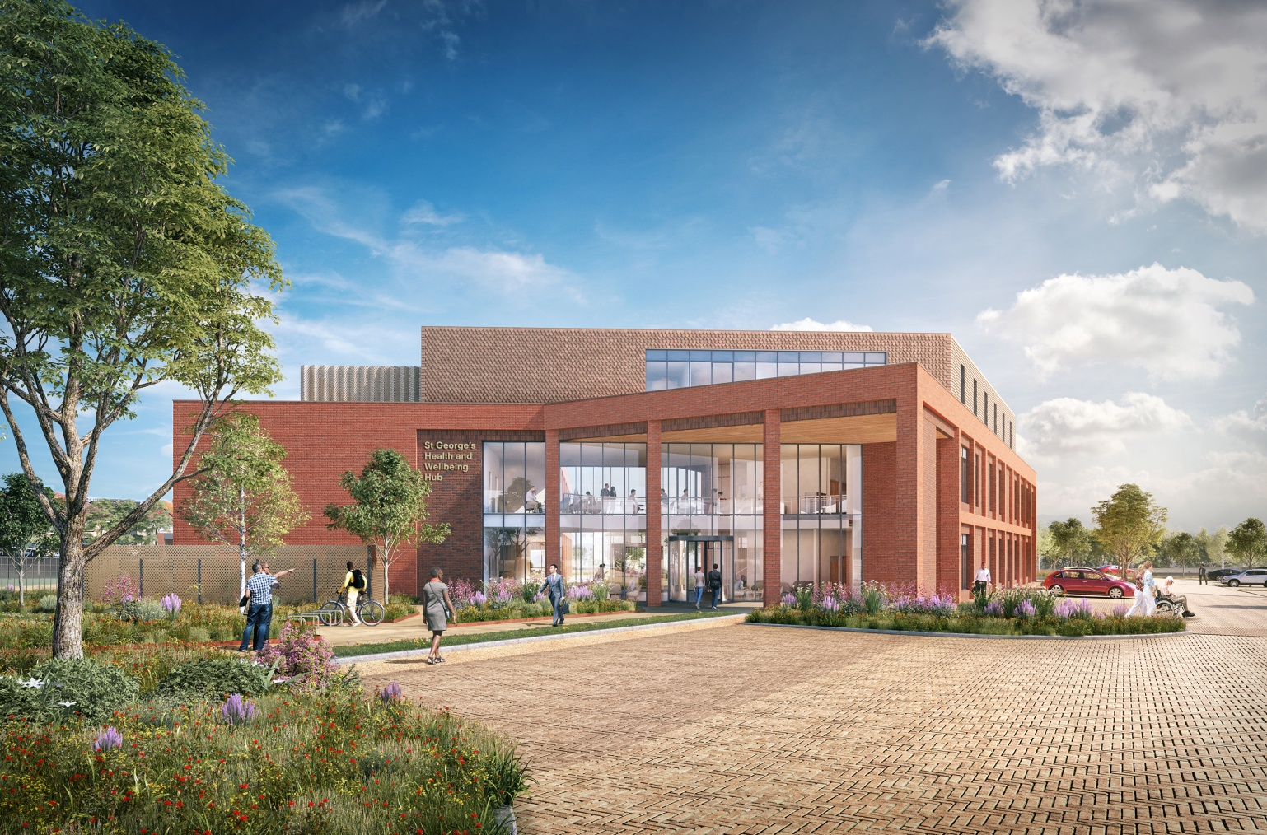
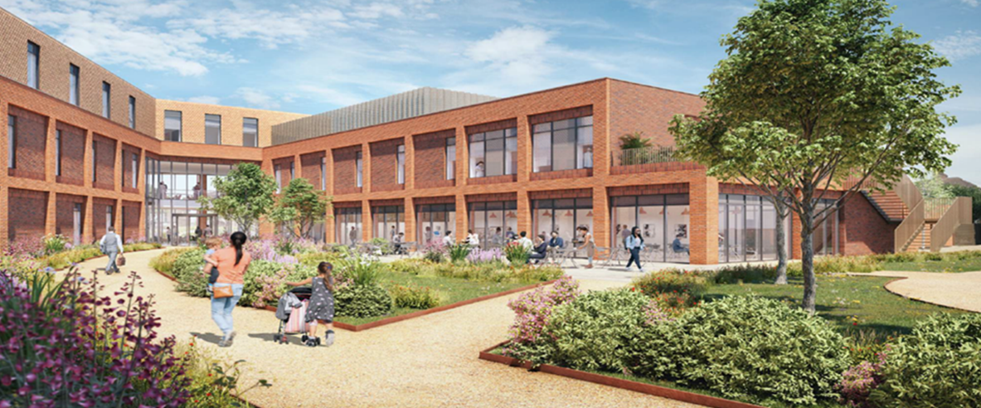
St George’s Health and Wellbeing Hub Listening event 27/11/21

Slide 3
Agenda
Welcome
Background
Our proposals
Why the hub makes sense
Overview of services
Frailty - closer look
Outpatients - closer look
GP services - closer look
Overall benefits
Questions
We have a clear clinical vision – to make the very best quality care available to people living in Havering and neighbouring areas. At the heart of our vision is keeping local people well and providing as much care as possible close to people’s homes.

Slide 4
Online survey
The online survey is the quickest way to share your views with us
www.surveymonkey.co.uk/r/WLNJRHL

Slide 5
Background
In autumn 2019, the Government announced it would allocate £17 million towards funding the project. Local GPs have been working with NHS partners from our local Clinical Commissioning Group, North East London NHS Foundation Trust (NELFT) and Barking, Havering and Redbridge University Hospitals NHS Trust (BHRUT) to develop the plans
Planning permission for the development was granted by Havering Council earlier this month (November 2021)
This new community base aims to provide integrated primary, community, mental health and local authority care services on a single, local community site located at the former St George’s Hospital site in Suttons Lane, Hornchurch

Slide 6
Under our proposals
We would bring together a range of services under one roof, in a brand-new fit-for-purpose Integrated Health and Wellbeing Hub in the community
Renal dialysis would move from Queen’s to the new Hub
Some local GP practices within a 2-mile radius of the Hub would relocate there
Some frailty, outpatient, wellbeing, mental health and early diagnostic services for cancer would be provided and the local authority would provide some adult and children services. Some space would be made available for wellbeing services and for local voluntary sector services.

Slide 7
Why the health and wellbeing hub makes sense
Better patient care…
The hub would have a range of services operating from one building, supporting more patient-centred integrated care. Patients would be able to access more services at the same time, in a purpose-built, convenient location. Resulting in increased independence for patients; and better patient outcomes
… in a high quality, flexible space…
The hub space would be flexible, so different health and care services will be able to be provided from the same space, and used by different organisations. Some weeks we might need more of one outpatient clinic, another week we might need an extra mental health session
The hub would have the space to train new clinical staff
The extensive landscaping would provide a relaxing environment for our patients and visitors and support people with memory loss
… using taxpayers money wisely.
A new, economical-to-run building, built to net zero carbon standards (ensuring it does minimum harm to the environment) with no backlog maintenance costs is good for taxpayers.
Better management of patients’ conditions in the community would result in fewer emergency unplanned visits and admissions – which reduces pressure on A&E, is better for patients and reduces costs

Slide 8
Overview of services
Outpatient services could include…
Vascular; Diabetes; Podiatry; Orthopaedics; Urology (prostate cancer); Maternity; Gastroenterology (physiology and bowel clinics); Phlebotomy; Psychology
Diagnostic services
New mobile CT and MRI scanners planned; and a space for a Community Diagnostic Hub so we can detect cancers sooner. We listened to concerns during the planning consultation about the noise of scanners and will make sure they are installed in sound proof pods so they make less noise.
Frailty, mental health and community services
Mental health and community services are in a variety of locations across, and sometimes out of the borough. Patients have to travel longer than necessary and teams are scattered across different sites. We plan to bring these services back to the hub location where they are best placed.
GP Services
We want to relocate some local GP practices to the hub, especially those that are in buildings that are too small for the growing local population. This would make for a more pleasant experience; and the GP practices would be able to offer a wider range of services; more clinics; better access and better training facilities.
Renal services
Renal dialysis does not need to be delivered from a major hospital. The hub would provide an improved healing setting for patients who spend up to 12 hours each week for months or years receiving treatment and would provide the space for training for self-dialysis which means patients can dialyse at their convenience without nursing supervision.

Slide 9
Frailty - closer look
Benefits for people:
Early assessments for frail older people to prevent hospital admission
An anticipated reduction of almost one third of frail elderly admission to Queen’s hospital as a result of attending the hub frailty service
Delayed discharges can be reduced as the Frailty service will provide capacity for follow-up assessments and referral once person is discharged from hospital
Direct access to diagnostics such as X-rays, which can also be used by the wider community if needed
The Hub will also provide an escalation of care facility. This is a point of referral for deteriorating patients who need urgent assessment. People can then be provided with an appropriate care package and able to return home, referred to social services, or referred to hospital for specialist support where this is necessary
Having diagnostics and clinical space under one roof, in a setting away from an acute hospital

Slide 10
Outpatients - closer look
Benefits for people:
Triage and virtual clinics so that the patient is seen by the right person at the right time in the right place with the correct information available to make decisions at their first clinic
• Care closer to home
• Improved co-ordination and integration of care

Slide 11
GP services - closer look
Benefits for people:
GP services based at the Hub will increase capacity for the growing population as well as provide better accommodation for patients and staff
The Hub will provide career opportunities and attract a younger and more varied workforce into primary care
GP services located in the same facility as diagnostics can help align and reduce delays in pathways of care

Slide 12
Overall benefits
• Be flexible and adaptable in the face of unprecedented change due to Covid-19
• Go to the patient, and not the patient to us
• Enable patients to see more than one professional in a single visit
• Stop the patient telling their story to more than one health professional. This will be assisted by shared technology between the different teams
• Co-locate different health and care teams to enable improved communication through building informal relationships and shared development opportunities
• Build a shared knowledge of patients, helping us to communicate better with our patients
• Reduce handover of care to reduce the risk of patients ‘falling through the gap’

Slide 13
Questions

Slide 14
Stakeholders, the public and patients are sharing their views on the new Hub from 22 November 2021 to 13 Feb 2022
For more information please go to our webpage:
https://northeastlondonccg.nhs. uk/SGHhub

